Slide 1
EXECUTIVE PRESENTATION
SQL • Python • Power BI
FIFA 2026 Player & Club Performance Analytics
An end-to-end data analytics framework converting 13K match records into actionable management insights, performance scoring models, and club benchmarking.
Presented by Rasika Pawar
DATASET SCOPE
CORE DELIVERABLE
TECHNICAL STACK
229 Players | 13K Match Logs
3-Page Interactive Power BI Dashboard
SQL • Python (Pandas/NumPy) • Power BI (DAX)

Slide 2




TECHNICAL FRAMEWORK
End-to-End Data Analytics Pipeline Architecture
1. SQL Layer
2. Python Layer
3. Power BI Layer
4. Management Value
Structured data extraction across match tables, complex joins, positional groupings, and multi-table aggregations.
Pandas and NumPy for data cleaning, per-90 metric calculation, performance scoring algorithms, and tier classification.
Interactive 3-page dashboard built with DAX measures, cross-filtering, dynamic slicers, and positional breakdown.
Translating raw performance records into squad recruitment, positional efficiency, and club benchmarking insights.

Slide 3
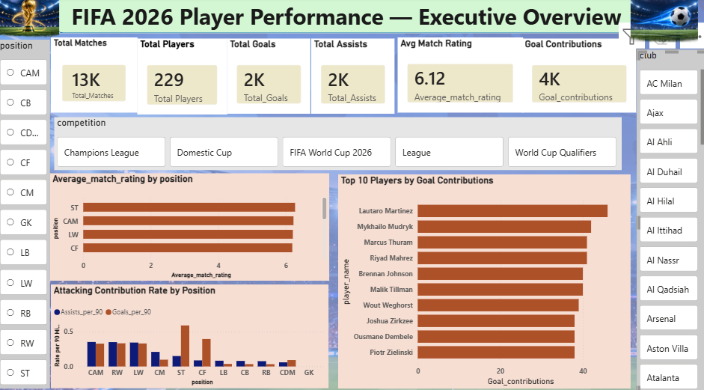
Page 1 — Executive Overview: Overall Performance Landscape
Core KPI Macro View
Captures 229 players across ~13K match records, recording 2K goals, 2K assists, and a 6.12 average match rating.
Top Attacking Contributors
Lautaro Martinez leads total goal contributions (45+), followed closely by Mykhailo Mudryk and Marcus Thuram.
Positional Breakdown
Attacking contribution rate highlights ST dominance, while match ratings remain balanced across key outfield roles (~6.12).

Slide 4
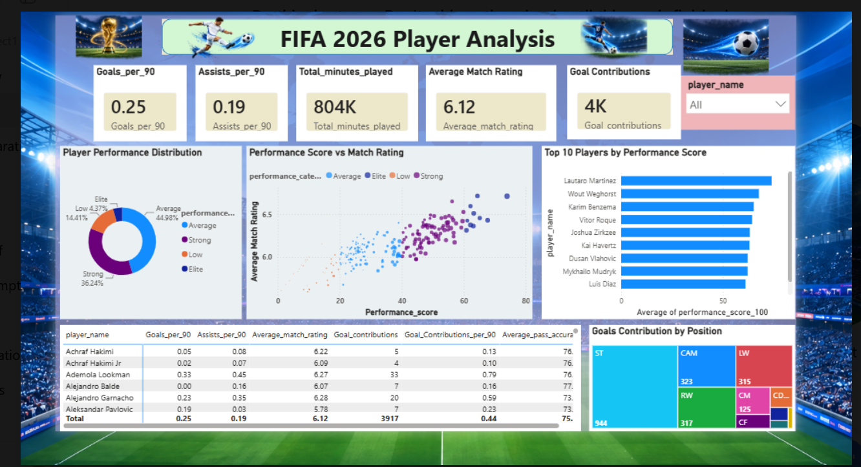
Page 2 — Player Analysis: Performance Score & Tier Distribution
Performance Segmentation
Distribution reveals 44.98% Average, 36.24% Strong, 14.41% Low, and a highly scarce 4.37% Elite talent group.
Python Model Validation
Scatter chart proves strong upward correlation between custom Python Performance Score and official Match Ratings.
Multi-Metric Profiling
Combines Goals/90 (0.25 avg), Assists/90 (0.19 avg), Match Rating, and Pass Accuracy (75.11%) for complete evaluation.

Slide 5
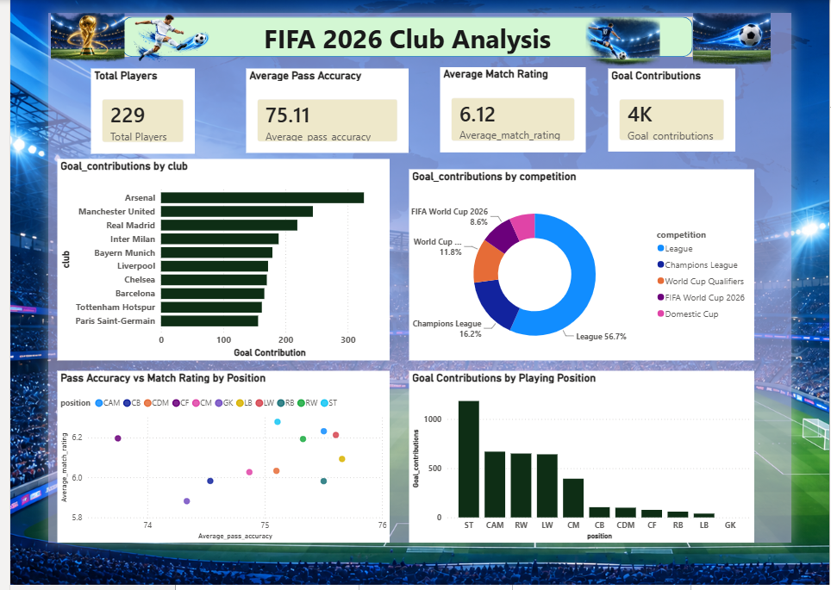
Page 3 — Club Performance: Benchmarking & Competition Split
Club Contribution Concentration
Arsenal leads overall goal contributions (~320), followed by Manchester United, Real Madrid, and Inter Milan.
Competition Share
League matches generate 56.7% of all contributions, Champions League 16.2%, and WC Qualifiers 11.8%.
Technical Quality Scatter
Maps Pass Accuracy vs Match Rating by position, contrasting CM high pass control against ST finishing focus.

Slide 6
Player Pool Scope & Performance Tier Concentration
INSIGHT 01
Overall Pool
INSIGHT 02
Scarcity Factor
Comprehensive Dataset Coverage
Elite Talent Concentration
The analysis evaluates 229 players across ~13K match records, tracking ~2K goals, ~2K assists, and a 6.12 baseline match rating.
81.2% of players fall into Average (44.98%) or Strong (36.24%) tiers. The Elite segment represents only 4.37% of the entire player pool.
Management Interpretation: Provides a broad, highly reliable foundation for benchmarking player participation and output.
Management Interpretation: Elite talent is extremely scarce; granular data differentiation is essential for squad evaluation.

Slide 7
Positional Output & Club Concentration Drivers
INSIGHT 03
Positional Focus
INSIGHT 04
Club Heavyweights
Striker & Attacking Output
Concentrated Top-Club Output
Strikers generate 944 goal contributions, followed by CAM (323), RW (317), and LW (315). Midfield and defense contribute through key passes and balance.
Goal contributions are heavily clustered in top European clubs, led by Arsenal, Manchester United, Real Madrid, Inter Milan, and Bayern Munich.
Management Interpretation: Non-forward evaluation must shift from raw goals to pass efficiency and positional rating indicators.
Management Interpretation: Establishes a concrete organizational benchmark for squad construction and competitive evaluation.

Slide 8
Competition Context, Model Validation & Multi-KPI Evaluation
INSIGHT 05
INSIGHT 06
INSIGHT 07
Competition Split
Python Model Alignment
Multi-KPI Evaluation
League matches drive 56.7% of total output, Champions League 16.2%, and World Cup Qualifiers 11.8%.
Scatter analysis confirms clear positive correlation between Python Performance Score and official Match Ratings.
Integrates Goals/90, Assists/90, Goal Contributions/90, Match Rating, and Pass Accuracy.
Takeaway: Player output must be context-adjusted by competition type.
Takeaway: Validates custom feature engineering against match performance.
Takeaway: Prevents single-metric bias in player valuation.

Slide 9
SQL Extraction & Python Feature Pipeline Architecture
SQL Database Layer
Python & Pandas Layer
Structured Querying: Multi-table joins across match logs, player master records, and club tables.
Feature Engineering: Normalized Goals/90, Assists/90, and Goal Contributions per 90 minutes.
Aggregation Accuracy: Zero-loss grouped match summaries across 13K total match records.
Scoring Algorithm: Weighted performance score model combining productivity, ratings, and pass precision.
Relational Integrity: Clean key modeling between player IDs, position groupings, and competitions.
Tier Categorization: Binned performance distribution into Average, Strong, Low, and Elite tiers.

Slide 10



VISUALIZATION & MODELING
Power BI Architecture & DAX Modeling Layer
DAX Measure Modeling
Interactive Cross-Filtering
Executive Page Flow
Custom DAX measures calculating total goals/assists, weighted per-90 averages, pass accuracy ratios, and dynamic KPI counts.
Configured dynamic slicers for Club, Position, Player, and Competition, enabling seamless drill-down from macro to micro level.
Structured across 3 distinct pages maintaining clear logical progression: Overview $\rightarrow$ Individual Deep Dive $\rightarrow$ Club & Competition Analysis.

Slide 11
Converting Raw Match Records into Actionable Business Value
SQL Data Infrastructure
Python Advanced Analytics
Leverages relational querying and aggregation logic to structure complex match logs efficiently without data loss.
Engineers custom performance scores and validates them against match ratings to provide secondary analytical depth.
Interactive Power BI BI
Actionable Management Decisions
Delivers a 3-page interactive dashboard empowering management to explore player, positional, and club trends dynamically.
Translates metrics into actionable recruitment, squad planning, and competitive benchmarking strategies.

Slide 12
PROJECT COMPLETE • FIFA 2026 ANALYTICS
FIFA 2026 End-to-End Analytics
"Converting raw football performance data into actionable player, club, and positional management insights through SQL, Python, and Power BI."
Thank you

